Slide 1

BANKING CUSTOMER 360
A unified, real-time view of every customer across Loans, Accounts, Credit Cards & Investments
Client : A Leading Global Bank
AWS Data Engineering Training Project | August 2026

Slide 2




The Problem: Customer data, Fragmented
Four products. Four silos. No single view of the relationship.
Bank can't see cross-sell opportunity, true relationship value, or regional risk
Accounts
Loans
Credit Cards
Investments
A total of 14,600 rows of synthetic (Full Load + CDC) test data was generated across the four verticals — Loans, Accounts, Credit Cards, and Investments — to validate the pipeline at scale."
3600
3600
3468
3500
3469
Customers
Accounts
Loans
Credit Cards
Investments
Banking Customer 360 | AWS Data Engineering Project
2

Slide 3
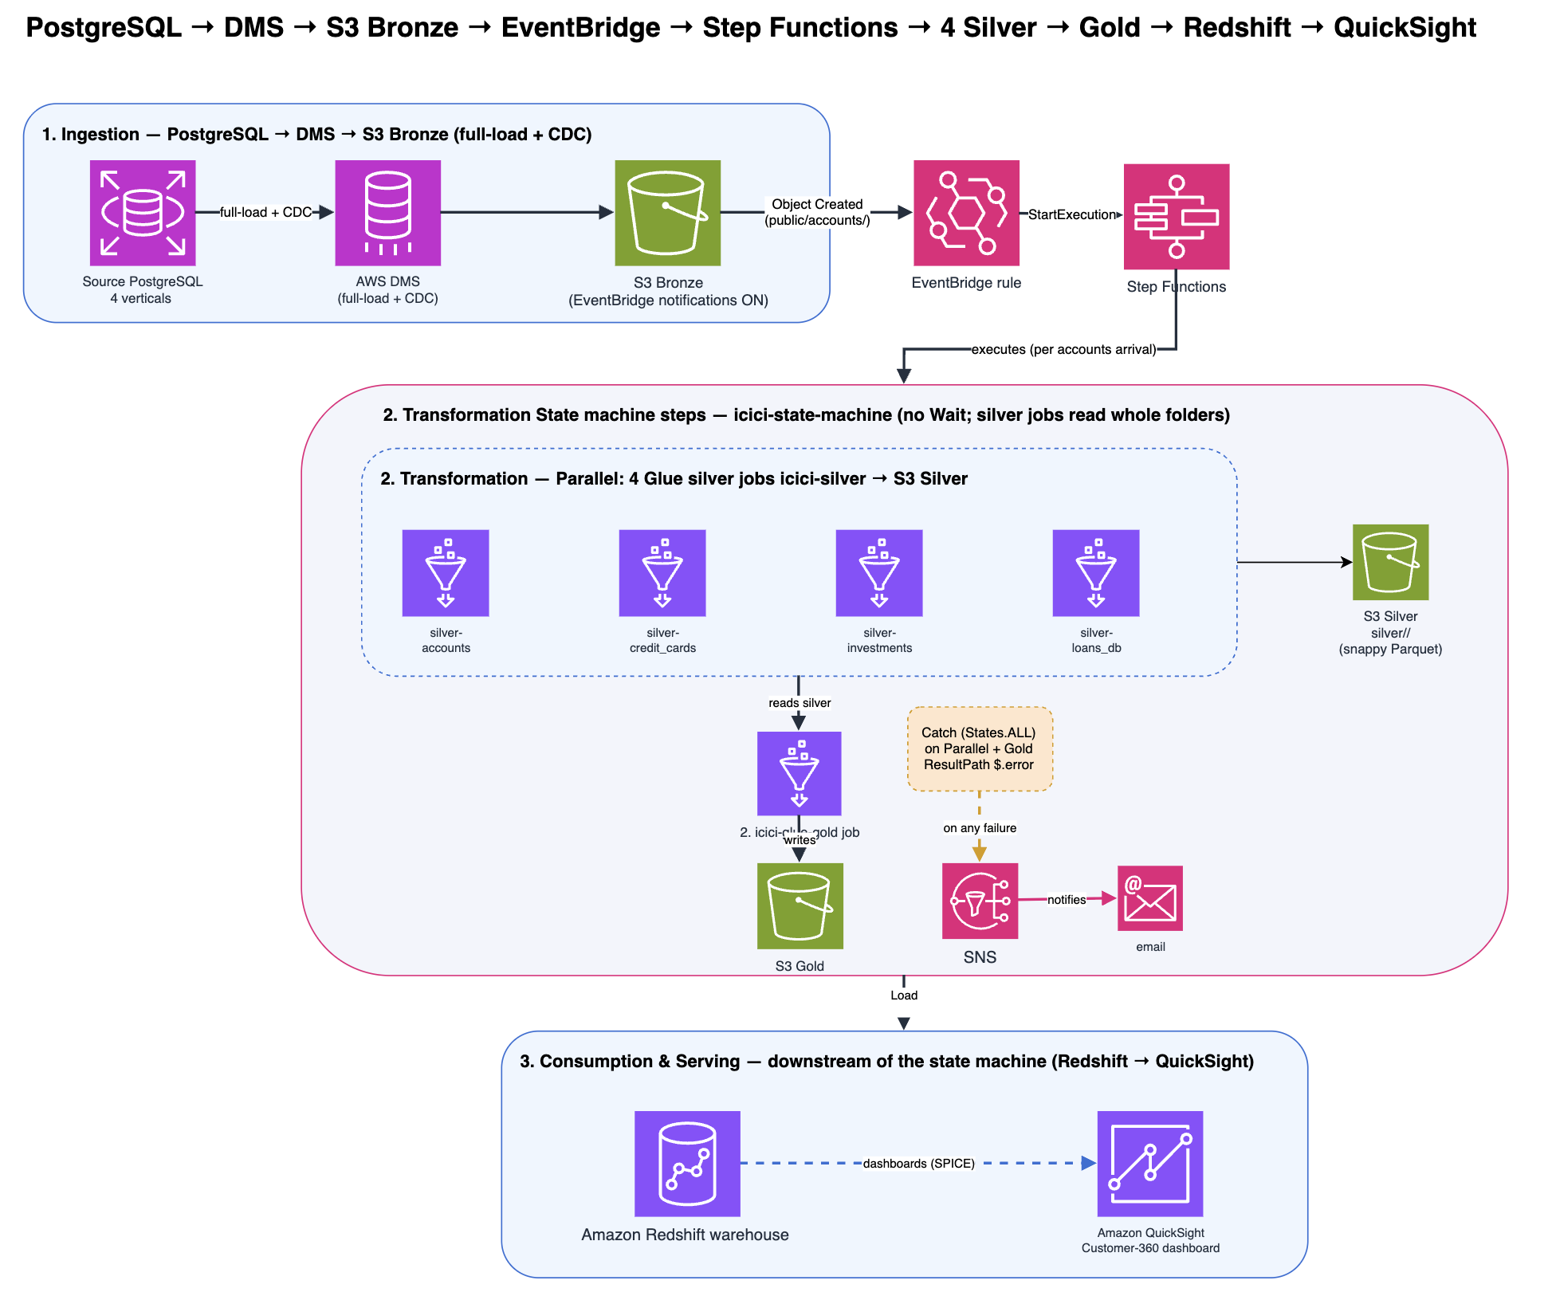
Banking Customer 360 | AWS Data Engineering Project
3

Slide 4



Refining the Data: Bronze → Silver → Gold
Every stage makes the data more trustworthy and more useful.
Bronze
Silver
Gold
Raw, as-is
Cleaned & flagged
Business-ready
Straight from the source — unfiltered, unformatted, untouched.
Types fixed, duplicates removed, issues flagged — never hidden.
One customer view, joined and modeled for instant analysis.
Banking Customer 360 | AWS Data Engineering Project
4

Slide 5




Challenges We Hit — And Solved
Real production-style problems, diagnosed and fixed, not avoided.
Corrupted import
CDC vs. Full Load formats
A misconfigured header setting silently scrambled a live table — caught, reverted, fixed at the source.
Incremental update files carry an extra hidden column — pipeline now auto-detects and adapts.
Network access
A misclassified column
Dashboard tool couldn’t reach the warehouse — resolved by routing traffic securely inside the private network.
An income category was wrongly read as a number, wiping its data — caught, corrected, verified.
Banking Customer 360 | AWS Data Engineering Project
6

Slide 6




What Makes This Architecture Different
Not just a pipeline — an engineered, cost-aware, production-realistic system.
One engine, four products
Nothing hidden
CDC-aware by design
A single reusable pipeline handles all product lines — not four separate ones.
Every data issue is flagged and traceable, never silently dropped.
Built to recognize and capture incremental change, not just one-time loads.
Cost-conscious
Honest trade-offs
Tested like production
Serverless, pay-per-use choices throughout — no idle infrastructure billing.
Where shortcuts were taken under deadline, they're documented — not hidden.
Deliberately dirty test data proves the pipeline holds up, not just the happy path.
Banking Customer 360 | AWS Data Engineering Project
7

Slide 7




From Data to Decisions
Four real banking questions, answered instantly.
Cross-Sell
High-Value Clients
Regional Performance
Product Adoption
Which customers hold only a savings account — the biggest untapped opportunity.
Rank customers by total relationship value across all products.
Compare Products sale across region.
See which product — Loans, Cards, or Investments — customers choose most.
Banking Customer 360 | AWS Data Engineering Project
8

Slide 8
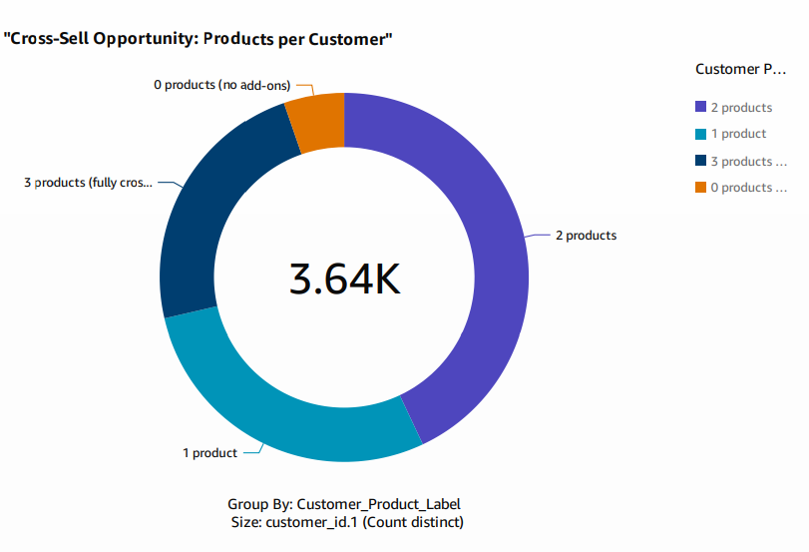
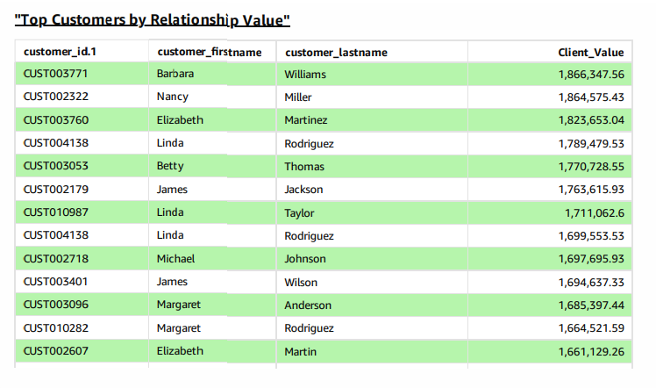

Slide 9
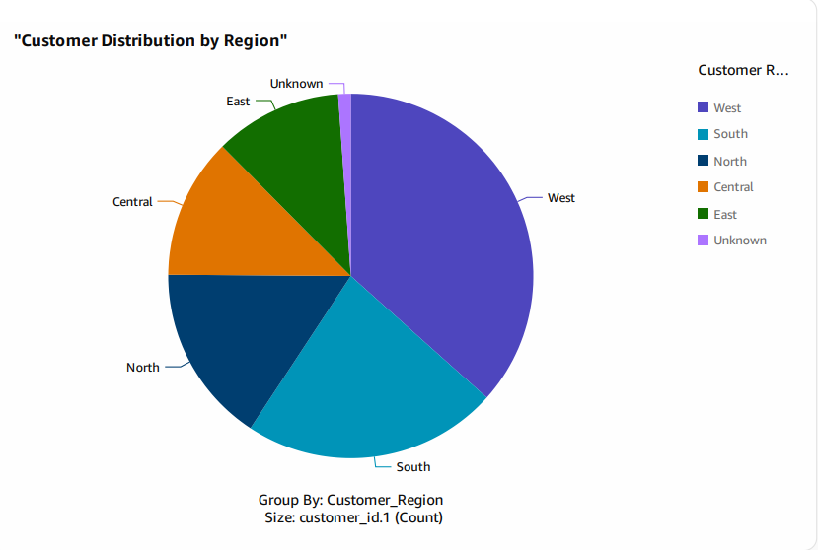
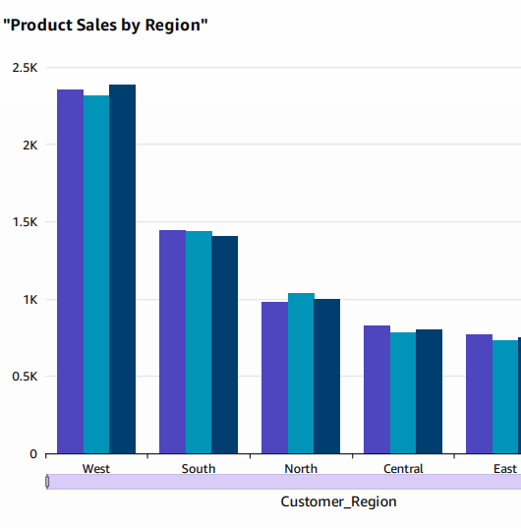

Slide 10
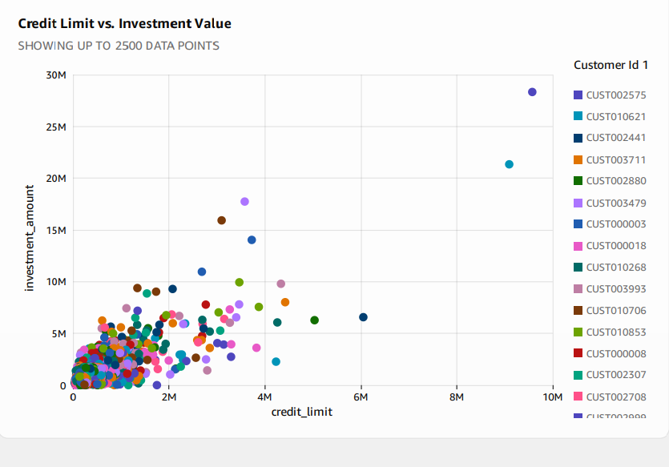
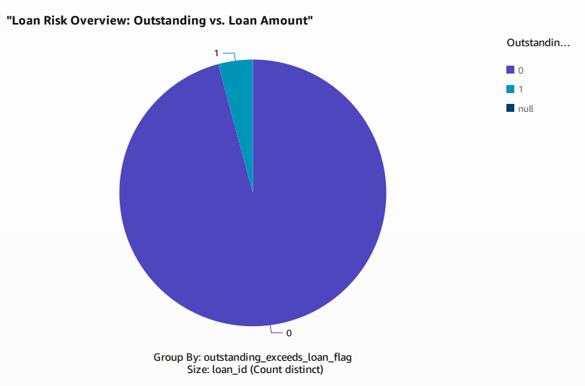

Slide 11


What's Next
The roadmap toward a fully self-updating, production-grade platform.
Smart updates (MERGE)
Full automation
Native quality rules
Self-adapting schema
Update only what changed, instead of reloading everything.
Zero manual steps from data upload to dashboard refresh.
Formalize checks using AWS Glue's built-in data quality engine.
Automatically detect new columns as the business evolves.
Thank You
Questions welcome.
From Ganesh & Priya

